Slide 1
BestTeam' ; DROP
TABLE Students; --
CS 562 ESQL Demo
Colby Foster, Anthony Santilli

Slide 2
ESQL and SQL
Create a program which returns a script to process and return a query written in the PHI operator form (S, n, V, F, r, G)
Aggregations and grouping → simple to explain, hard to execute in normal SQL
Multi-feature queries → express without multiple queries or subqueries
Aggregates → defined with SUCHTHAT clause
Our program allows these types of queries to be expressed more efficiently
Easier to write and understand
Works via scans rather than joins → less computation overall

Slide 3
Topics and Parts
Code Structure
Query Structure
Generator File
Libraries
Limitations
Conclusions

Slide 4
Code Structure
readinput.py
Read values of input / file
Give values of MF_struct
generator.py
_generated.py
result table
All operations handled in generator.py:
Scans
Parsing SUCHTHAT and HAVING

Slide 5
Query Structure
Read from file by the generator program in .txt format, input passed to readinput.py
S and F are comma-separated, as is suchthat when processed via user input
F-vector → list of lists for each grouping var, and each aggregate in grouping var
From file read, suchthat separated by lines → list of conditionals for each grouping variable
Example query:
SELECT ATTRIBUTE(S):
cust, 1_sum_quant, 2_sum_quant, 3_sum_quant
NUMBER OF GROUPING VARIABLES(n):
3
GROUPING ATTRIBUTES(V):
cust
F-VECT([F]):
1_sum_quant, 1_avg_quant, 2_sum_quant, 3_sum_quant, 3_avg_quant
SELECT CONDITION-VECT([σ]):
1.state = 'NY'
2.state = 'NJ'
3.state = 'CT'
HAVING_CONDITION(G):
1_sum_quant > 2_sum_quant * 2 or 1_avg_quant > 3_avg_quant
Output from readinput.py:
S: ['cust', '1_sum_quant', '2_sum_quant', '3_sum_quant']
n: 3
V: ['cust']
F: [[('1', 'sum', 'quant'), ('1', 'avg', 'quant')], [('2', 'sum', 'quant')], [('3', 'sum', 'quant'), ('3', 'avg', 'quant')]]
r: ["1.state='NY', 1.quant > 10", "2.state='NJ'", "3.state='CT'"]
G: 1_sum_quant > 2 * 2_sum_quant or 1_avg_quant > 3_avg_quant

Slide 6
Generator File
if groupVar == 0 and (row[ATTRIBUTE_INDEX['state']] == 'NY' and row[ATTRIBUTE_INDEX['quant']] < 10)
or groupVar == 1 and (row[ATTRIBUTE_INDEX['state']] == 'NJ' and row[ATTRIBUTE_INDEX['quant']] < 10)
or groupVar == 2 and (row[ATTRIBUTE_INDEX['state']] == 'CT' and row[ATTRIBUTE_INDEX['quant']] < 10):
Parsing SUCHTHAT clause:
1.state = 'NY' and 1.quant < 10
2.state = 'NJ' and 2.quant < 10
3.state = 'CT' and 3.quant < 10

Slide 7
Technology
Database: Postgres
Language: Python
Libraries:
  psycopg2
    Or psycopg2-binary
  Tabulate
  Python-dotenv

Slide 8
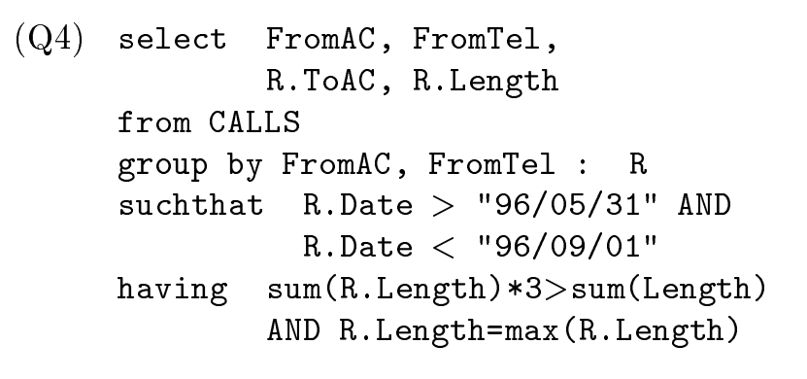
Limitations
Must use strict format for input
Generally no error checking and expects you to input things correctly
Some queries are slightly more complicated than they have to be
If you have nothing in the aggregate, then besides avg it just shows “0”
  avg throws error
No support for minimal scanning

Slide 9
Conclusion
Our implementation of MF and EMF query processing for tables makes queries that use group-by and aggregates much simpler to write and more efficient to process, saving time and cost for anyone analyzing a database.
If we were to improve our project, we could combine some loops to improve the performance, add robust error checking, and allow queries to be implemented as easily as the MF/EMF structure theoretically allows for.

